Slide 1

Hybrid Systems

Slide 2
What is Hybrid System?
Many real-life applications are so complex that they cannot be solved by the application of a single algorithm. This situation has necessitated the need to develop algorithms that mix two or more of the studied algorithms.
The choice of algorithms depends on the needs and characteristics of the problem. These mixed systems, called hybrid systems.
Hybrid systems use two or more specialized algorithms in an interconnected manner. These algorithms complement each other and solve the problems faced by the other algorithms. Hybrid systems as a whole present a robust system that can handle real-life inputs even better that single algorithms.

Slide 3
What is Hybrid System?
We will put the different constituents together to make effective systems. In this ,we mainly study six systems :
Modular ANNs, which introduce the concept of modularity in ANNs
Adaptive neuro-fuzzy inference systems (ANFIS), which use neural networks to learn fuzzy systems.
Fuzzy neural networks, which are ANNs that take fuzzy inputs.
Evolutionary ANNs, which use genetic algorithm (GA) to evolve ANNs.
Evolutionary fuzzy systems, which use GA to evolve fuzzy inference systems (FIS).
Rule extraction in ANNs, which extract fuzzy rules from a trained ANN

Slide 4
Artificial Neural Networks
ANNs are known for their ability to generalize and learn from past data. They can approximate almost any function without having any predefined idea of the problem or its solutions.
The highly parallel nature of ANNs further encourages their use in real-life applications and systems.
However, ANNs are limited in that they need a high amount of training data. If there is not enough training data, the Ann’s performance is very bad.
Another problem is that the parameters (number of neurons, hidden layer) must be manually fixed. A change in these parameters can bring a paramount change in the system’s performance.

Slide 5
Fuzzy Systems
Fuzzy systems, as is clear from the name, are known for impreciseness. They can solve problems very effectively by adding impreciseness to the systems.
The size of the training data needed to validate the system does not need to be large, because the rules govern the outputs. The computational requirement in these systems is fairly low.
However, fuzzy systems cannot be effectively used when the rules governing the mapping of inputs to outputs is not well known.
A change of parameters may make a paramount difference in the system’s performance..

Slide 6
Genetic Algorithms
GAs are very good optimizers. They can be used for almost any kind of optimization, which is of a great value in real-life problems.
GAs can be used to optimize various parameters and to solve many problems in real time; these solutions may otherwise not be possible in finite time.
Logic and AI-Based Systems
Logic in the form of production rules and AI methods are also employed in hybrid systems. Logic and AI-based systems provide precise logic and rules that drive the output. They provide exact outputs in the required computational time.
However, they fail when the dimensionality of data is large or when the time required is larger than what we can afford.

Slide 7
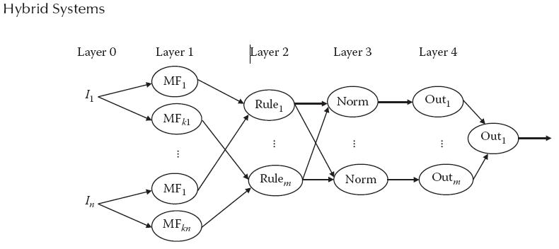
Adaptive Neuro-Fuzzy Inference Systems
The adaptive neuro-fuzzy inference system (ANFIS) belongs to the class of systems commonly known as neuro-fuzzy systems. Neuro-fuzzy systems combine the powers of ANN with those of fuzzy systems.
The general architecture of ANFIS.

Slide 8
Adaptive Neuro-Fuzzy Inference Systems
This procedure leads to long cycles of system modification and evaluation. This process goes on and on until decent levels of accuracy are met, which means the designer must have a lot of patience when attempting to design an effective system.
ANNs, on the other hand, have great powers of learning. They can learn large volumes of data by adjusting their parameters.
However, unlike fuzzy systems, ANNs do not work on the concept of rules, a concept that is often desirable in terms of design.

Slide 9

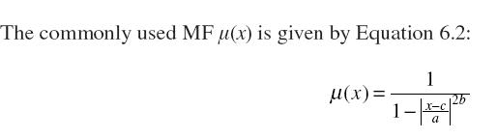
General Architecture
The general architecture of ANFIS, which is primarily a fuzzy system are:
Layer 0
In this layer, the inputs are presented to the system. Apart from applying the inputs, this layer does not perform any other function.
Layer 1
In this first layer of the ANN, fuzzification is carried out, which is why this layer is sometimes called the fuzzification layer.
According to figure, this would receive an input of Ii. Let the output produced by this neuron be Oij, where Oij 1 is given by Equation 6.1:

Slide 10


General Architecture
Layer 2
This layer represents the AND operation that is found in the antecedents in any fuzzy rule. Each neuron of this layer takes its various inputs from the preceding layer. It returns just one output, which is usually the product of the inputs.
Here this neuron takes as its input the fuzzified inputs from the first layer (Oij 1). The output is the final “ANDed” result (Wk 2) of the neuron corresponding to the kth rule.
Layer 3
The third layer is called the normalization layer. The output (Wk 2) that we received from Layer 2 is actually referred to as the rule’s firing power. This output denotes, or symbolizes, the relative importance of the rule.

Slide 11
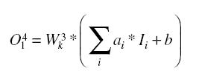
General Architecture
Layer 4
This layer calculates the individual output for every rule. For simplicity, we have taken only one output variable.
The output of this layer, however, is much generalized and is given by Equation 6.5:
where ai and b are parameters and Ii is the input from the previous layer. We will study the role of these parameters in the later sections of this chapter.
Layer 5
This layer simply takes the weighted sum of the outputs of Layer 4 to give the final answer of the system.

Slide 12
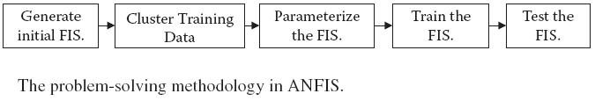
Problem Solving in in ANFIS
In this section, we develop a general problem-solving methodology for ANFIS.
Hybrid Systems
The motivation of ANFIS is to train the FIS using neural network architecture. We start with an initial FIS for the purpose of training.
Initial FIS
As stated above, we start by generating an initial FIS, which may be used for training by the system. If the initial FIS is not generated, we may use a randomly generated FIS with predefined inputs and a predefined number of MFs per input.

Slide 13
Problem Solving in in ANFIS
Clustering Training Data
In some cases, the data may be too large for the network to train. Training with a large amount of data may result in the training time be too large. For this reason, the training data is often clustered to reduce it to a manageable size.
Parameterization of the FIS
The next step is to add parameters to the generated FIS model. These parameters have a special relevance to the FIS in that they help the ANN implement the ANFIS to fine-tune the system.
Hence the system’s performance should improve with an increase in the number of parameters, which, in turn, increases the degrees of freedom associated with the FIS.

Slide 14
Problem Solving in in ANFIS
Training
A training algorithm is used to adjust the parameters that we introduced in the previous step. This training algorithm finds the most optimal set of values for which the training data follow the training data as closely as possible with the least errors.
Testing
Finally, the modified FIS is ready to handle the known and unknown inputs. This may be used directly for the implementation.

Slide 15
Training
The training adjusts the parameters of the FIS. This adjustment greatly improves the system’s performance. Two very commonly used training algorithms are the back propagation algorithm and hybrid learning.
Back Propagation Algorithm
A similar mechanism is followed to train the ANFIS. Here the inputs are applied, and then the outputs are calculated. The error is measured as a difference of the actual and the observed output.
Hybrid Training
Hybrid training is a special algorithm that tries to train the ANFIS in two stages: the forward stage and the backward stage.
The first are the premise parameters, which are found on the left side of the implication. These parameters are nonlinear in nature. The second classification is the consequent parameters, found on the right side.

Slide 16
Types of ANFIS
ANFIS may be classified into various types, depending on the rules or logic used. We briefly discuss the different classifications in this section.
OR type: This system uses OR logic for the various rules that are framed. The OR logic connects the MFs in an OR manner.
AND type: This system connects the rules with the help of the AND operator, as we discussed earlier.
Furthermore the ANFIS may be divided on the basis of the governing logic:
Mamdani type: This system is based on the Mamdani logic.
Logical type: Here the FIS uses a logical working of the rules.

Slide 17
Convergence in ANFIS
The training graph of the ANFIS, in which we plot the errors against training iterations, behaves in a similar manner to the training graph of the ANN. While training in ANFIS, we see that as the iterations grow, the error gets smaller, and the outputs of the inputs given to the ANFIS closely follow actual values.
Hence the training curve of the ANFIS actually converges.
The first is for training, the second for validation, and the third for testing. In this way, we were able to induce ANN over FIS and to optimize the FIS parameters.
Doing so reduced the necessity of using trial and error to make an FIS. Furthermore the resulting FIS gives high performance while also following the properties of the FIS.

Slide 18
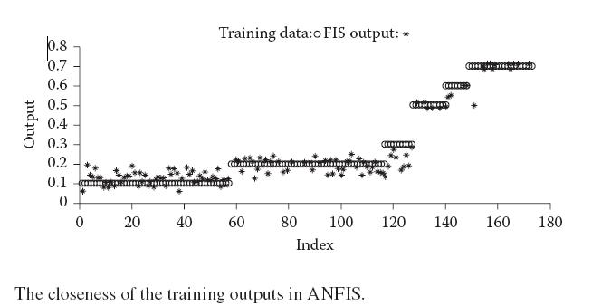
Application in a Real-Life Problem
In this section, we apply ANFIS to solve a real-life problem—that of glass identification (Box and Jenkins, 1970). This problem asks us to find the type of glass.
Hybrid System

Slide 19
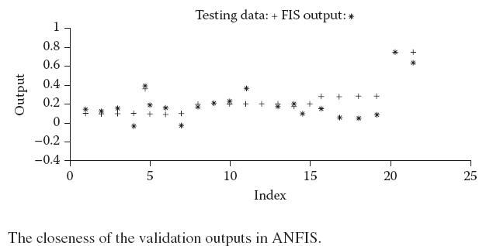
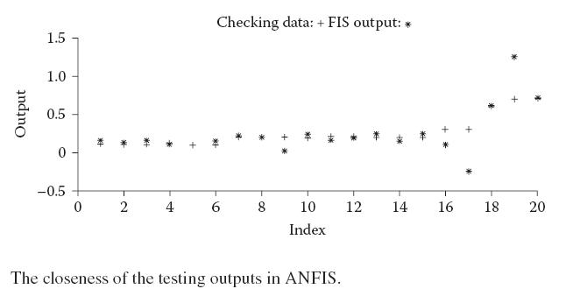
Application in a Real-Life Problem

Slide 20
Evolutionary Neural Networks
The ANN using BPA as a training algorithm still has shortcomings. It is quite likely that BPA results in some local minima in place of global minima. We also must specify the initial parameters before the learning can start.
The GA, on the other hand, is known for its ability to optimize. In this section, we fuse this capability of the GA with the ANN’s ability to train.
We study the problem of the ANN’s evolution on two levels. First we try to evolve an ANN that has a fixed structure. Then we generalize this solution to evolve the structure of the ANN, as well as the weights and other parameters.

Slide 21
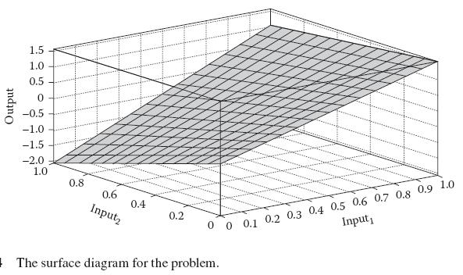
Evolutionary Neural Networks
Evolving a Fixed-Structure ANN
In this case, the ANN’s structure is fixed. This may be decided by the user beforehand. The GA fixes the values and the weights and biases of the various nodes.

Slide 22
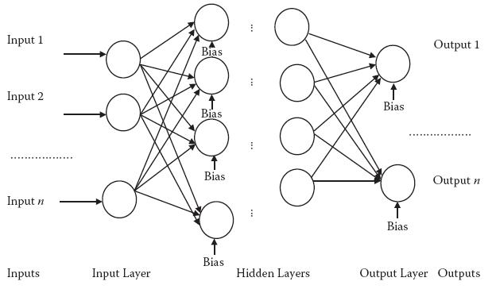
Evolutionary Neural Networks
Hybrid System

Slide 23
Evolving a Fixed-Structure ANN
Problem Encoding
This system has I * H weights between the input layer and the hidden layer and H * O weights between the hidden layer and the output layer, making the total number of weights W I * H + H * O. Furthermore the number of biases is equal to the number of neurons.
All of these weights and outputs are the system parameters that need to be optimized. This means that for a single-layer ANN, I * H + H * O + H + O parameters must be optimized.
Genetic Operators
All standard genetic operators (see Chapter 5) are used, including selection, crossover, eliticism , mutation, and so on.
The genetic operators ensure creation of good individuals from one population to the next.

Slide 24
Evolving a Fixed-Structure ANN
Fitness Function
In the fitness function, we first create and initialize an ANN according to the various parameters that the GA generated in the individual.
Hence every time the GA demands the measurement of fitness value of some individual, the ANN is created, and the value is measured by the performance. This interfaces the GA with the ANN during training.
Testing
Once the GA reaches its optimal state and terminates per the stopping criterion, we get the final values of the weights and biases.
We can then use this for testing. Note that validation data are not necessarily required in this type of training.

Slide 25
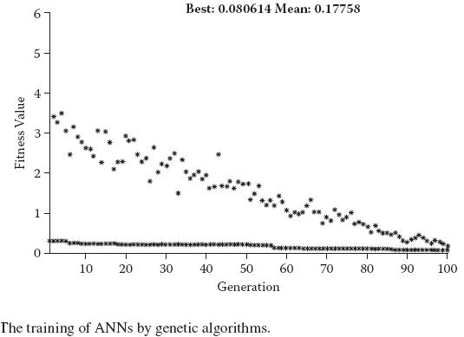
Evolving a Fixed-Structure ANN
Experimental Verification
In this step, we experimentally verify the evolutionary ANN by using it to solve a real-life application
The training curve showing the average and mean values is given in Figure 6.6. The root mean square error (RMSE) for the trained ANN is 0.080614 on training data and 0.0919 on testing data.

Slide 26
Evolving -Variable Structure ANN
In the previous section, we saw an interesting application of GA in ANN in which we trained an ANN with the help of GA.
Problem encoding in this case may be done in two ways: direct encoding or grammatical encoding.
Both are discussed below. We use the same notations as in the previous section for the rest of our discussion.
Direct Encoding
In direct encoding, the ANN’s entire structure is encoded directly into the chromosome. The chromosome now represents two things.
The first is the connection scheme that exists in the ANN, while the second is the actual weights of the ANN.

Slide 27
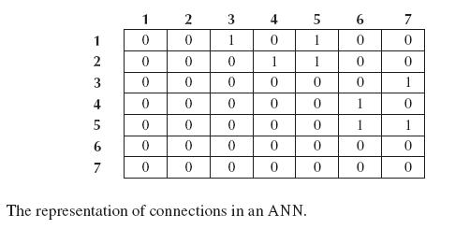
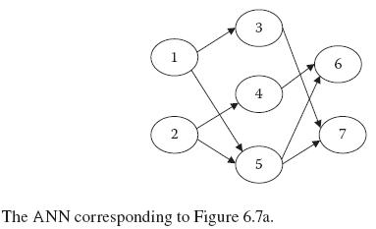
Evolving -Variable Structure ANN
Direct Encoding

Slide 28
Evolving -Variable Structure ANN
Grammatical Encoding
Grammatical encoding is a different style of coding that does not directly store the connections and weights. Instead, it uses grammar to store the information necessary to generate the architecture whenever needed.
This type of encoding has added features to the convergence and speed of the GA and is hence very useful.
Fitness Function
The fitness function in this method is the same as we discussed in the fixed-architecture model of the ANN.
We first form the architecture and then assign the weights to the different connections and biases. The rest of the procedure is the same as discussed above.

Slide 29

Evolving Learning Rule
Another exciting fusion of the ANNs with GA is done in the domain of learning rules. Here we use GA to evolve learning rules for the ANN.
We combine the learning capability of the ANN with the available learning base with the optimizing capabilities of the GA.
In a conventional ANN with BPA, the learning follows these steps: We first apply the inputs to the network to get the corresponding outputs.
The error is calculated by the difference between the current output and the desired output. Per the back propagation fundamentals, this error is back propagated through the previous layers to adjust their weights.
The change in weight may hence be represented as given in Equation 6.6:

Slide 30
Evolving Learning Rule
Here we assume that the learning rule should be a linear function of these variables and all their pairwise products—that is, the general form of the learning rule is as given in Equation 6.7:
where the km (1 < m < 10) are constant coefficients and k0 is a scale parameter that affects how much the weights can change on any cycle.
In these systems, we use GA to evolve the values of the constants km’s. The encoding of these constants may be done in a double-vector or bit-string format.

Slide 31
Evolving Fuzzy Logic
In this section, we use a combination of FIS and GA for the purpose of problem solving. FIS are known for their ability to create systems based on lingual rules and to handle uncertainty.
One of the major disadvantages to FIS is that the rules must be clearly defined because they govern the mapping of the inputs to the outputs.
In this system, we use the GA’s optimization powers in the FIS, similar to how we used GA for the training of ANNs.
The first covers the evolution of the FIS with fixed rules. The second is the entirely generalized form, in which we evolve the entire FIS along with the structure.

Slide 32
Evolving a Fixed-Structure FIS
We first evolve a fixed FIS. Because much of the discussion is similar to that of the evolutionary ANN, we mainly address problem encoding here.
Because the structure of the FIS is fixed, the number of MFs for all inputs, outputs, and rules has already been decided.
The MFs can be of any shape and size and can be at any location. They may have any number of parameters. For simplicity, we assume that all MFs are Gaussian in nature, which means they have two parameters through which we decide the spread and location of the Gaussian function.
All these parameters are represented in a single array with values one after the other. We may represent these parameters using either a double-vector or a bit-string mechanism.
We take the optimized values of the parameters that the GA returns. We then generate the final FIS using these parameters as the values of the MF parameters.

Slide 33
Experimental Verification
The FIS used has the same structure as the one we used in the problem in Chapter 4. Recall from that chapter that the problem was to make a robot reach the goal starting from a given source. The system had two inputs—the angle and the goal.
The input angle has five MFs. The extreme two of them were trapmf in nature, whereas all others are Gaussian MF. The other input (distance) has three MFs associated with it, all of which are Gaussian in nature. The output has five MFs, all of which are Gaussian in nature.
Similarly the three MFs of the input distance take six parameters and the five MFs of the output take ten parameters. This makes the total number of variable parameters 26. Thus the total number of variables in GA is 26.

Slide 34
Experimental Verification
Hybrid Systems
Rule1: If (a is morep) then (output is morer)
Rule2: If (a is lessp) then (output is lessr)
Rule3: If (a is no) then (output is no)
Rule4: If (a is lessn) then (output is lessl)
Rule5: If (a is moren) then (output is morel)
Rule6: If (a is not morep) and (goal is distant) then (output is no)
Rule7: If (a is not moren) and (goal is distant) then (output is no)
Rule8: If (a is lessp) and (goal is near) then (output is morer)
Rule9: If (a is lessn) and (goal is near) then (output is morel)
The fuzzy rules for the robotic control problem.

Slide 35
Experimental Verification
We use two factors to measure the performance. The performance P for any single test case i is hence given by Equation 6.8:
Pi = Li * Ti
where Li denotes the length of the path for test case i and Ti denotes the maximum turn taken by the robot. Both factors are normalized to lie between 0 and 1.
The total fitness F for any individual is the sum of performances in the three benchmark maps, as given in Equation 6.9:
F = P1 + P2 + P3
The GA optimizes the various parameters using the double-vector method of population representation. The total number of individuals in the population is 20. A uniform creation function, rank-based scaling function, and stochastic uniform selection method is used.
The crossover rate is fixed at 0.8.

Slide 36
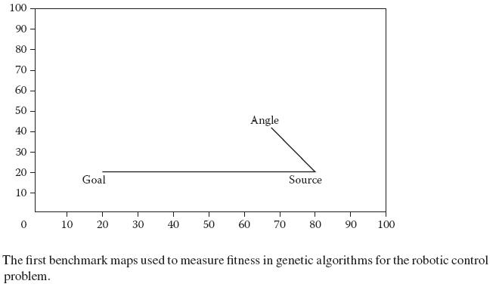
Experimental Verification
The mean and best fitness of the population at various generations are shown in Figure 6.10.

Slide 37
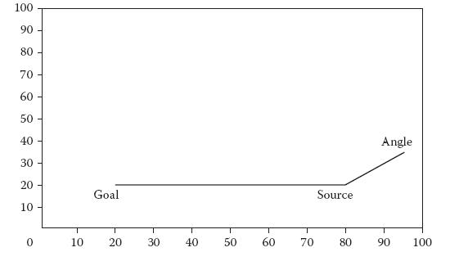
Experimental Verification
The first benchmark maps used to measure fitness in genetic algorithms for the robotic control problem.

Slide 38
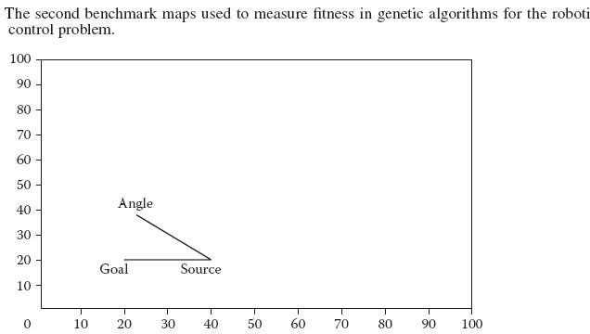
Experimental Verification

Slide 39
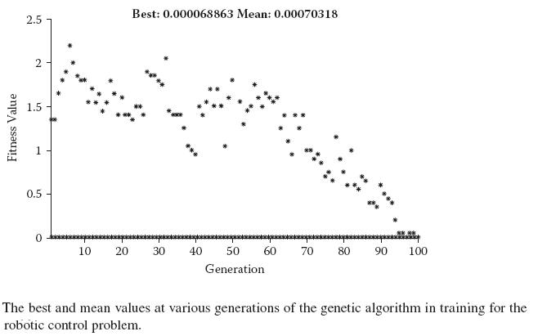
Experimental Verification

Slide 40
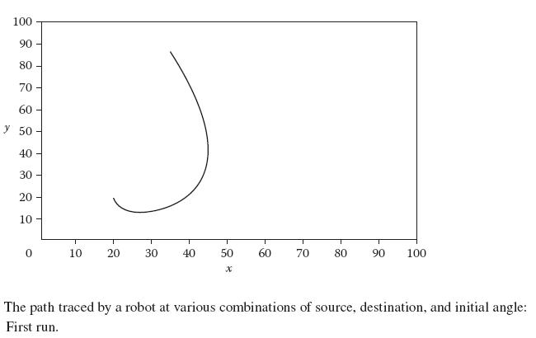
Experimental Verification
Hybrid System

Slide 41
Fuzzy Artificial Neural Networks with Fuzzy Inputs
We have already modeled the FIS by ANN architecture and saw that the FIS could be made to learn. We did this using the neuro-fuzzy systems. Here we will combine the powers of ANN with that of fuzzy logic (FL).
We do so to make the ANN benefit from the FL by making it capable of handling uncertain or imprecise inputs.
This has led to the modeling of impreciseness or fuzziness in almost every problem that we find. The models accounting for this impreciseness can handle data much better than the other systems.

Slide 42
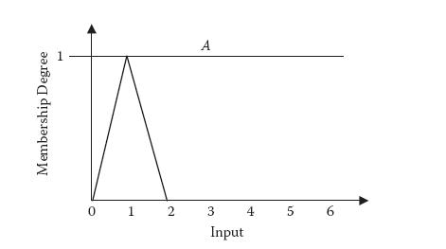
Fuzzy Arithmetic Operations
ANN calculation of an output for any input or learning using BPA uses some arithmetic operators both to predict the output and to learn.
Hence the major task before us is to form fuzzy equivalents of these arithmetic operations.
Hybrid System

Slide 43
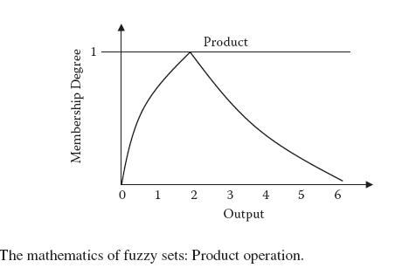
Modified BPA
To learn the available database, the fuzzy neural networks use the learning algorithm, which is a modified form of the BPA.
Here we apply the fuzzy inputs, look at the fuzzy output, and calculate the fuzzy error that is passed backward (or back propagated) to the previous layers.

Slide 44
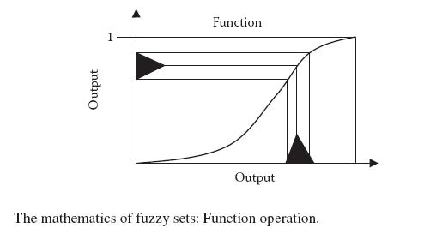
Modified BPA
Hybrid System
Learning Algorithm in Fuzzy ANN with Fuzzy Inputs
Step 1: Initialize the network
Step 2: While stopping condition not met
Step 3: For all h = h1, h2, . . ., hn
Step 4: For all input, output pair i in data set
Step 5: Calculate fuzzy output o
Step 6: Calculate fuzzy error e
Step 7: Back propagate and adjust fuzzy weights according to error e

Slide 45
Modular Neural Network
Modular neural networks (MNNs) are modular implementations of ANNs. The basic motivation is to divide the entire complex task or problem into much more manageable problems.
Hence MNNs are very useful in problem solving because they make many problems realizable that were not possible in the earlier architectures.
This has led to the modeling of impreciseness or fuzziness in almost every problem that we find. The models accounting for this impreciseness can handle data much better than the other systems.
Need for MNNs
If we try to solve a complex problem with ANNs, we face various problems, including a limited time required for training.
Another problem is that ANNs tend to forget past data when they are exposed to new data, especially when the data are not presented for long.
This performance further reduces with addition of noise or unknown data.

Slide 46
Biological Inspiration
The idea behind modularity was inspired from the natural systems. Modularity exists in the human brain.
Every part of the brain has some specific task. One part is responsible for hearing, another for thinking, and so on.
Modularity in ANN
Modularity is the breaking up of a complex task into a set of simpler tasks. Each task may be done by some independent or dependent component or system.
In other words, it should be possible to divide the entire problem into sets of problems in such a manner that they can be handled by different systems. These divided problems are known as modules.
In the first, known as soft modularity, there is some dependency among the various divided problems or modules.
In the second modularity, known as hard modularity, the various modules work entirely independent of one another.

Slide 47
Working of the MNNs
The parts of the problem are then solved separately by each module, with each module finding its own respective results.
After the various modules have been solved, they are communicated to the central component, called the integrator.
The working of the MNN is similar in concept to the divide-and-conquer approach. This approaches believes in dividing the task into a set of related smaller tasks. This division is known as the divide stage.
The work in MNNs lies at two levels. The first level is the division of the problem into subproblems. The second level is the integration of the various subproblems and the formulation of the final result from the individual results.
Other nonlinear approaches were also used, including Baysean networks, Dampster-Shafer belief theory, and fuzzy modeling. We will study some of these techniques in the next section.

Slide 48
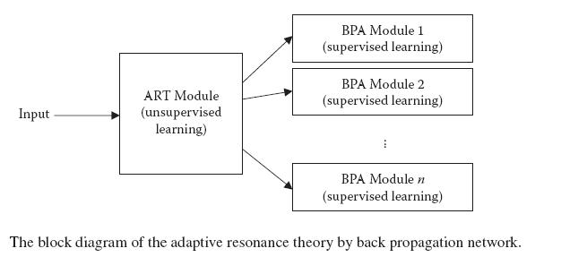
ART-BP Network
This ANN contains the unsupervised ART for dividing the problem into constituent modules or ANNs.
The training of this ART is done in an unsupervised manner, and it mainly clusters the training data and divides it into various modules. Each ANN is trained using a supervised BPA. Each ANN is an ART network.

Slide 49
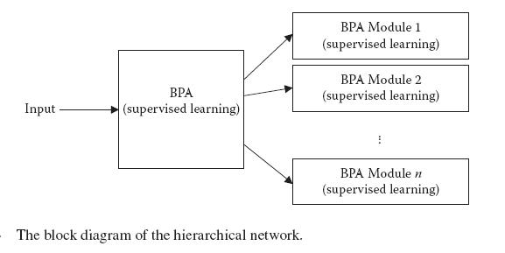
ART-BP Network
Hybrid Systems
Hierarchical Network
This network contains a BPA at the two hierarchies.
The information at this level is very vague and not accurate. The final solution is generated by the next ANN, which uses BPA to get the final answer.

Slide 50
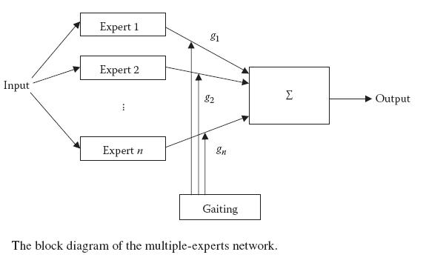
Multiple-Experts Network
With this network, the basic motivation is to solve the same problem using a variety of experts or ANNs.
The differences in the various ANNs may be introduced by varying the number of neurons, architecture, or initial weights.
Fuzzy reasoning or any other method may also be used for integration.

Slide 51
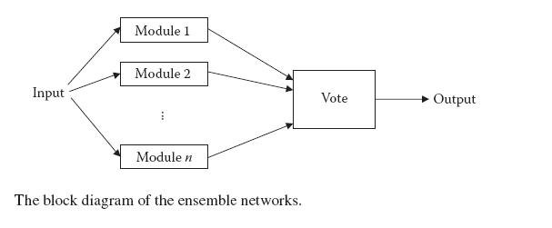
Ensemble Networks
Ensemble networks consist of multiple networks that are identical in nature. Each network solves the problem according to its own parameters.
In this case, each network nominates one class that it believes the input belongs to. The result is based on the class that gets the maximum votes.

Slide 52
Hierarchical Competitive Modular Neural Network
Hierarchical competitive modular neural networks (HCMNNs) contain a hierarchy of ART networks. The lower hierarchy (also called the stem ART) has a low level of detail and classification.
The higher level (also called the leaf ART) has a relatively higher detail. This higher ART maps the input to the ANN using supervised BPA.
Merge-and-Glue Network
In this network, we first divide the task based on heuristics according to the problem’s logic. This distributes every problem to the networks.
Learning can then be resumed in this larger network, starting from the network’s error configuration.
We also add some more neurons, which are supposed to discover more features as they are exposed to more training data. These neurons are known as glue.

Slide 53
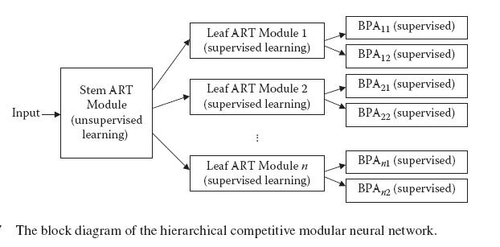
Merge-and-Glue Network
The basic working of this type of network is given in Figure 6.18.

Slide 54
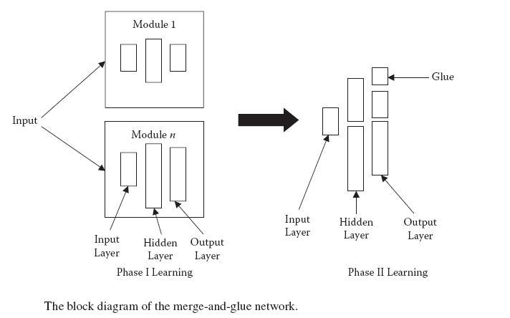
Merge-and-Glue Network
Hybrid System

Slide 55
Chapter Summary
In this chapter, we presented the intensely useful systems that are built by fusing the properties of previously studied systems, including artificial neural networks, genetic algorithms, fuzzy inference systems, artificial intelligence, and logic.
The first system discussed results from the fusion of FIS with ANN, which generated the adaptive neuro-fuzzy inference systems (ANFIS)
The genetic algorithm (GA) was then used to evolve ANNs, in a process known as evolutionary ANN. The system was discussed under two he
A similar system is one that uses GA with FIS. This time, the GA was used to evolve FIS. Again we saw that the application of GA led to the evolution of an FIS that showed great performance.
The application of GA further ensured that the system would reach global optima.ads: fixed architecture and variable architecture.
Throughout the text, we looked at various real-life problems and solved these problems by the discussed methods.

Slide 56
Solved Examples
1. In MNNs, is it preferable to have a large number of modules or a low number of modules? Explain.
Answer: For this example, we consider the MNN in which the problem is divided and subdivided in each hierarchy. In this manner, the solution is generated.
The increase in hierarchy, or the number of modules, is a great boon to execution time. As the modules increase, the running time gets smaller and smaller.
The increase in the number of modules, however, also has a negative effect. The generalizing capability of the ANN continues to decrease as we increase the number of modules.
Furthermore an increase in the number of modules means an increase in the system’s memory requirements.
Suppose we keep increasing the number of modules to the degree that the number of modules is equal to the number of inputs. Now every module has effectively one input to train and test.

Slide 57
Solved Examples
2.How do you handle the problem of missing data in experiments using fuzzy ANNs?
Answer: Fuzzy ANNs can take both fuzzy and nonfuzzy inputs, which allow them to handle the experiments that have missing values. This can happen in both training and testing phases.
Consider an experiment with n attributes. An entry in this experiment may be represented as <x1, x2, x3, . . ., xn>. These form the inputs to the ANN. The ANN may be used for functional approximation between the inputs and the outputs. In general, the inputs would be well determined, and we would be able to work with them using fuzzy or nonfuzzy ANNs.
Suppose that this attribute had legal values in the range of a to b. We replace the missing value entirely by this range in order to give the fuzzy input to the ANN. The input given to the ANN would be <x1, [a b], x3, . . ., xn>.
This method would work both in the training and the testing phase. Furthermore the uncertainties in the output can be handled in a similar manner.

Slide 58
Solved Examples
3.It is better to have the number of rules being extracted out of the ANN the least in number with limited MFs and antecedents. Explain.
As was the case with ANNs, in which we saw that the fewer the neurons, the greater the generalizing capability. The same happens to be true with FIS.
Here the number of rules needs to be as small as possible. The more rules, the more difficult it will be for us to conceptualize and understand the system. Similarly, the generalizing power decreases as the rules of MFs increasing.
Consider the system with n training data cases. Each is of the form <I1, I2, I3, Ik, O1, O2, O3, Ol>, where there are k inputs and l outputs. For every input we frame a rule “If (Input1 is MI1) and (Input2 is MI2) and (Input3 is MI3) . . ., then (Output1 is MO1) and (Output1 is MO1) and (Output1 is MO1) . . .” where each MI1, MI2, MI3, . . ., MO1, MO2 MO3is an MF with centers at I1, I2, I3, . . ., O1, O2, O3, . . . respectively and of width such that every MF extends from the center of the maxima of the previous MF and goes to the maxima of the next MF.

Slide 59
Solved Examples
4.Explain the importance of controlling the number of neurons in evolutionary ANN.
We know that any good ANN solves the problem given with the highest performance and the least number of neurons and layers. The evolutionary ANN does not respect this fact. Hence it may often generate large networks that may not perform well when testing data. This would result in reduced performance.
Various modifications to the earlier discussed model are necessary to cater to these needs. We must start with the networks that have low neurons as the initial solution. This would control the network from growing too much. In addition, very large networks being generated may be reframed or repaired at the start.
Further mutation and crossover need to be modified to keep the size of the network from growing rapidly.

Slide 60
Questions
. General Questions
1. What are hybrid systems? What is the advantage of using hybrid systems in place of nonhybrid systems?
2. What is the role of production rules and artificial intelligence (AU) in hybrid systems? Give an example.
3. In what sense is ANFIS better than (a) ANN? (b) FIS?
4. What are evolutionary ANN and FIS? Compare and contrast.
5. What is the use of having fuzziness in ANNs?
6. What do we mean by modularity in neural networks? Under what circumstances is it beneficial?
7. What is the use of extracting rules from ANNs?
8. Compare and contrast the system of rule extraction from ANN to that from ANFIS.
9. Name a few MNNs. Briefly explain the working of each.
10. Why is it better to have a low number of rules extracted when extracting rules from ANNs?

Slide 61
Questions
General Questions
11. Suggest a method for implementation of evolutionary ANNs. Is there a possibility of generating infeasible solutions? If yes, how would you deal with those solutions?
12. Compare the generalizing capability of the MNNs with that of the ANNs.
13. How is fuzzy arithmetic different from conventional arithmetic? Discuss the major operators of fuzzy arithmetic.
14. Explain the grammatical evolution of ANN.
15. Compare the search spaces of the two means of evolution of variable-architecture ANNs.

Slide 62
Questions
General Questions
16. Explain the working of the various layers of ANFIS.
17. Why are modifiable parameters kept high in ANFIS? Does it affect the training data size requirements?
18. Based on the discussed systems, explain how the ANN, GA, and FIS complement each other.
19. Explain the characteristics of good rules extracted from a trained ANN.
20. What is the advantage of fuzzy ANNs over conventional ANNs?

Slide 63
Questions
Practical Questions
1. Download any database from UCI Machine Learning Repository and solve the problem using the various hybrid methods discussed in this chapter.
2. Consider the iris database we used for clustering in Chapter 1. Now cluster the same data by dividing them into the least number of clusters such that the average distance of every data element di from its corresponding center ci is always less than some threshold a: | di – ci | < a. Use evolutionary algorithms.
3. Write grammatical rules for the evolution of (a) ANN and (b) FIS by grammatical evolution. Test these rules on any real-life application.

